Slide 1
Chapter 6: Transport Layer
Our goals:
Understand principles behind transport layer services:
Multiplexing/demultiplexing
Reliable data transfer
Flow control
Congestion control
Learn about transport layer protocols in the Internet:
UDP: connectionless transport
TCP: connection-oriented transport
TCP congestion control

Slide 2
Keypoints and Difficulties
Keypoints:
Port numbers
TCP
Difficulties:
TCP connection management
TCP Reliable data transfer
TCP congestion control

Slide 3
Chapter 6 Outline
6.1 Transport-layer services
6.2 Multiplexing and demultiplexing
6.3 Connectionless transport: UDP
6.4 Connection-oriented transport: TCP
Segment structure
Connection management
Flow control
Reliable data transfer
6.5 TCP congestion control

Slide 4
Transport Services and Protocols
Provide logical communication between app processes running on different hosts
Transport protocols run in end systems
Send side: breaks app messages into segments, passes to network layer
Rcv side: reassembles segments into messages, passes to app layer
More than one transport protocol available to apps
Internet: TCP and UDP
application
transport
network
data link
physical
network
data link
physical
network
data link
physical
network
data link
physical
logical end-end transport
network
data link
physical
network
data link
physical
application
transport
network
data link
physical

Slide 5
Transport vs. Network Layer
Network layer:
Logical communication between hosts
Transport layer:
Logical communication between processes
Relies on, enhances, network layer services

Slide 6
Transport vs. Network Layer
Household analogy:
12 kids sending letters to 12 kids
Processes = kids
App messages = letters in envelopes
Hosts = houses
Network-layer protocol = postal service
Transport protocol = Ann and Bill

Slide 7
Internet Transport-Layer Protocols
Reliable, in-order delivery (TCP)
Congestion control
Flow control
Connection setup
Unreliable, unordered delivery: UDP
No-frills extension of “best-effort” IP
Services not available:
Delay guarantees
Bandwidth guarantees
application
transport
network
data link
physical
network
data link
physical
network
data link
physical
network
data link
physical
logical end-end transport
network
data link
physical
network
data link
physical
application
transport
network
data link
physical
Notes:
Frills:装饰

Slide 8
Chapter 6 Outline
6.1 Transport-layer services
6.2 Multiplexing and demultiplexing
6.3 Connectionless transport: UDP
6.4 Connection-oriented transport: TCP
Segment structure
Connection management
Flow control
Reliable data transfer
6.5 TCP congestion control

Slide 9
Multiplexing/Demultiplexing
1 host ←→ 1 or more processes
1 process ←→ 1 or more sockets
Transport layer interacts with socket
Demultiplexing at rcv host
Multiplexing at send host
= socket
= process
application
application
application
P4
P3
P1
P2
P1
transport
transport
transport
network
network
network
link
link
link
physical
physical
physical
host 1
host 2
host 3
host 1
Notes:
Socket套接字：相当于从网络向进程传递数据和从进程向网络传递数据的门户，每个套接字都有唯一的标识符
对UDP而言，套接字相当于端口号，包含2元组（目的IP，目的端口号）
对TCP而言，因为其是面向连接的，TCP 使用“连接”(而不仅仅是“端口”)作为最基本的抽象，同时将 TCP 连接的端点称为套接字(socket) ，所以其套接字是4元组，包括源和目的IP地址
服务器主机同时支持多个并发的TCP套接字:每一个套接字都由其四元组来标识

Slide 10
Multiplexing/Demultiplexing
Segment - unit of data exchanged between transport layer entities
aka TPDU: transport protocol data unit
Demultiplexing at rcv host: : delivering received segments to
correct app layer processes
through socket
receiver
P3
P4
application-layer
data
M
M
application
transport
network
segment
header
P1
P2
M
M
application
transport
network
application
transport
network
segment
H
t
M
H
segment
n
Notes:
Aka:亦称

Slide 11
How Demultiplexing Works
Host receives IP datagrams
Each datagram has source IP address, destination IP address
Each datagram carries 1 transport-layer segment
Each segment has source, destination port number (recall: well-known port numbers for specific applications)
Host uses IP addresses & port numbers to direct segment to appropriate socket
32 bits
source port #
dest port #
other header fields
application
data
(message)
TCP/UDP segment format
Notes:
端口的作用就是让应用层的各种应用进程都能将其数据通过端口向下交付给运输层，以及让运输层知道应当将其报文段中的数据向上通过端口交付给应用层相应的进程（或者线程）
从这个意义上讲，端口是用来标志应用层的进程（或者线程）：端口用一个 16 bit 端口号进行标志
对UDP而言，套接字相当于端口号，包含2元组（目的IP，目的端口号）
对TCP而言，因为其是面向连接的，TCP 使用“连接”(而不仅仅是“端口”)作为最基本的抽象，同时将 TCP 连接的端点称为套接字(socket) ，所以其套接字是4元组，包括源IP,源端口号和目的IP地址、目的端口号
服务器主机同时支持多个并发的TCP套接字:每一个套接字都由其四元组来标识

Slide 12
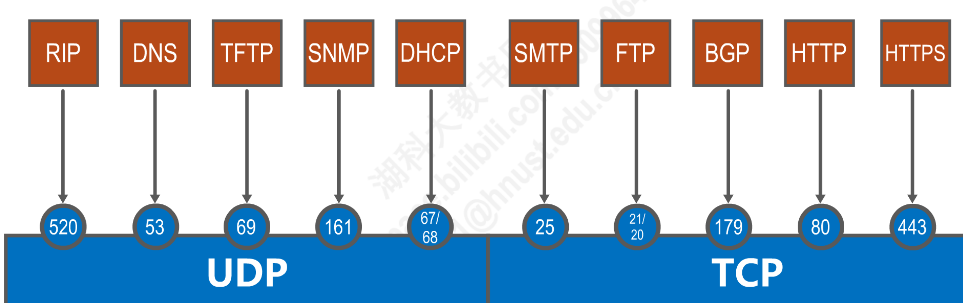
Well-known port number
The port number only has local meaning, and the same port number in different computers is not related.

Slide 13
Multiplexing/Demultiplexing
Multiplexing at send host:
gathering data from multiple sockets, enveloping data with header (later used for demultiplexing)
Multiplexing/demultiplexing
Based on sender, receiver port numbers, IP addresses
<source IP #, dest. IP#, source port #, dest. port#>

Slide 14

Multiplexing/Demultiplexing: examples
source port: x
Web client Host C
dest. port: 23
Host A
Server B
source IP: C
source IP: C
source port: 23
dest. IP: B
dest. IP: B
dest. port: x
source port: y
source port: x
dest. port: 80
dest. port: 80
port use: simple telnet app
source IP: A
dest. IP: B
Web client Host A
source port: x
Web Server B
dest. port: 80
port use: web server

Slide 15
Connectionless Demultiplexing
Create sockets with port numbers:
DatagramSocket mySocket1 = new DatagramSocket(12534);
DatagramSocket mySocket2 = new DatagramSocket(12535);
UDP socket identified by two-tuple:
(dest IP address, dest port number)
When host receives UDP segment:
Checks destination port number in segment
Directs UDP segment to socket with that port number
IP datagrams with different source IP addresses and/or source port numbers directed to same socket

Slide 16
Connectionless Demux (cont)
DatagramSocket serverSocket = new DatagramSocket(6428);
P2
P3
P1
SP: 6428
SP: 6428
DP: 9157
DP: 5775
SP: 9157
SP: 5775
client
IP: A
DP: 6428
server
IP: C
DP: 6428
Client
IP:B
SP provides “return address”

Slide 17
Connection-Oriented Demux
TCP socket identified by 4-tuple:
Source IP address
Source port number
Dest IP address
Dest port number
Recv host uses all four values to direct segment to appropriate socket
Server host may support many simultaneous TCP sockets:
Each socket identified by its own 4-tuple

Slide 18
Connection-Oriented Demux (cont.)
P1
P4
P5
P6
P2
P3
SP: 5775
DP: 80
S-IP: B
D-IP: C
SP: 9157
SP: 9157
client
IP: A
DP: 80
server
IP: C
DP: 80
Client
IP:B
S-IP: A
S-IP: B
D-IP: C
D-IP: C

Slide 19
Connection-Oriented Demux: Threaded Web Server
P1
P4
P2
P3
SP: 5775
DP: 80
S-IP: B
D-IP: C
SP: 9157
SP: 9157
client
IP: A
DP: 80
server
IP: C
DP: 80
Client
IP:B
S-IP: A
S-IP: B
D-IP: C
D-IP: C

Slide 20
Chapter 6 Outline
6.1 Transport-layer services
6.2 Multiplexing and demultiplexing
6.3 Connectionless transport: UDP
6.4 Connection-oriented transport: TCP
Segment structure
Connection management
Flow control
Reliable data transfer
6.5 TCP congestion control

Slide 21
UDP: User Datagram Protocol [RFC 768]
“No frills,” “bare bones” Internet transport protocol
“Best effort” service, UDP segments may be:
Lost
Delivered out of order to app
Connectionless:
No handshaking between UDP sender, receiver
Each UDP segment handled independently of others
Why is there a UDP?
No connection establishment (which can add delay)
Simple: no connection state at sender, receiver
Small segment header
No congestion control: UDP can blast away as fast as desired

Slide 22
UDP: more
Often used for streaming multimedia apps
Loss tolerant
Rate sensitive
Other UDP uses
DNS
SNMP
Reliable transfer over UDP: add reliability at application layer
Application-specific error recovery!
32 bits
Length, in
bytes of UDP
segment,
including
header
source port #
dest port #
length
checksum
Application
data
(message)
UDP segment format
Notes:
检验和字段检验的范围包括首部和数据这两部分。在计算检验和时，要在 UDP 报文段的前面加上 12 字节的伪首部。

Slide 23
Chapter 6 Outline
6.1 Transport-layer services
6.2 Multiplexing and demultiplexing
6.3 Connectionless transport: UDP
6.4 Connection-oriented transport: TCP
Segment structure
Connection management
Flow control
Reliable data transfer
6.5 TCP congestion control

Slide 24
TCP: Overview RFCs: 793, 1122, 1323, 2018, 2581
End-to-End:
One sender, one receiver
In-order byte steam:
No “message boundaries”
Reliable :
TCP congestion and flow control set window size
Connection-oriented:
Handshaking (exchange of control msgs) init’s sender, receiver state before data exchange
Full duplex data:
Bi-directional data flow in same connection
MSS: maximum segment size
Notes:
TCP可靠传输：差错控制+流量控制+确认重传, 和数据链路层的可靠传输机制不一样的地方1）编号采用按字节编号，而非按报文段编号，引出seq和ACK的定义
什么是基于字节流？引出下一张PPT
全双工：背回技术
TCP 只规定了一种选项，即最大报文段长度 MSS (Maximum Segment Size)。MSS 告诉对方 TCP：“我的缓存所能接收的报文段的数据字段的最大长度是 MSS 个字节。

Slide 25
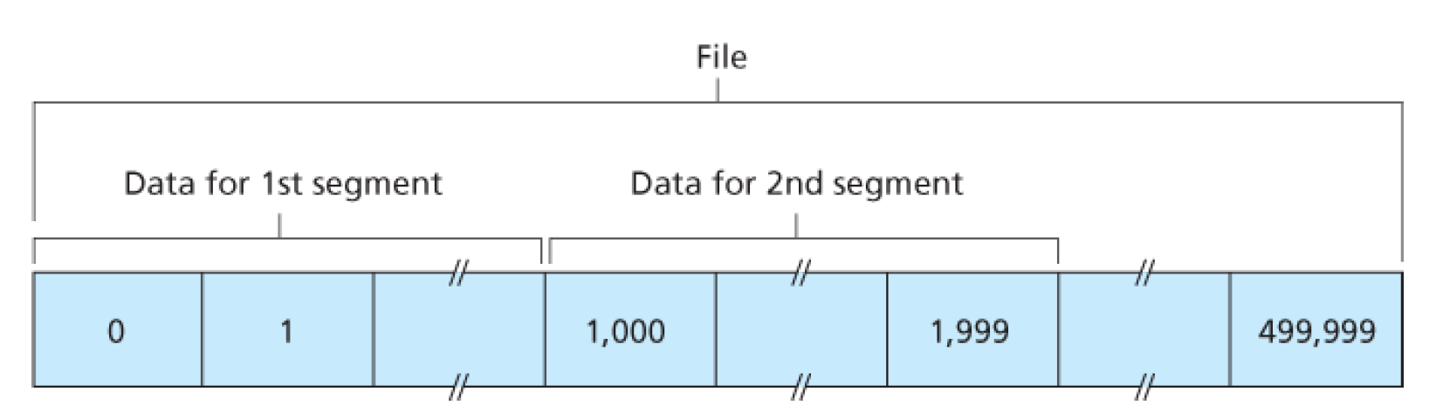
TCP: byte stream
Each byte is numbered in segment’s data
E.g., Suppose that a process in Host A wants to send a stream of data (a file of 500,000 bytes) to a process in Host B over a TCP connection. MSS is 1,000 bytes, and the 1st byte is numbered 0.
Seq # of the 1st segment: 0; Seq # of the 2nd segment: 1000;
Seq # of the 3rd segment: ?

Slide 26
TCP Seq. #’s and ACKs
Simple telnet scenario
Host A
Host B
User
types
‘C’
Seq=42, ACK=79, data = ‘C’
host ACKs
receipt of
‘C’, echoes
back ‘C’
Seq=79, ACK=43, data = ‘C’
host ACKs
receipt
of echoed
‘C’
Seq=43, ACK=80
time

Slide 27
TCP Segment Structure
32 bits
URG: urgent data
(generally not used)
counting
by bytes
of data
(not segments!)
source port #
dest port #
sequence number
ACK: ACK #
valid
acknowledgement number
head
len
not
used
U
Receive window
A
P
R
S
PSH: push data now
(generally not used)
F
# bytes
rcvr willing
to accept
checksum
Urg data pnter
RST, SYN, FIN:
connection estab
(setup, teardown
commands)
Options (variable length)
application
data
(variable length)
Internet
checksum
(as in UDP)
Notes:
源端口和目的端口字段——各占 2 字节。端口是运输层与应用层的服务接口。运输层的复用和分用功能都要通过端口才能实现。
序号字段——占 4 字节。TCP 连接中传送的数据流中的每一个字节都编上一个序号。序号字段的值则指的是本报文段所发送的数据的第一个字节在整个报文字节流中的序号。
确认号字段——占 4 字节，是期望收到对方的下一个报文段的数据的第一个字节的序号。
首部长度——占 4 bit，它指示意32bit为单位的TCP首部长度。
保留字段——占 6 bit，保留为今后使用，但目前应置为 0。
紧急比特 URG —— 当 URG = 1 时，表明紧急指针字段有效。它告诉系统此报文段中有紧急数据，应尽快传送。（一般不使用）
确认比特 ACK —— 只有当 ACK = 1 时确认号字段才有效。当 ACK = 0 时，确认号无效。
推送比特 PSH (PuSH) —— 接收 TCP 收到推送比特置 1 的报文段，就尽快地交付给接收应用进程，而不再等到整个缓存都填满了后再向上交付。
复位比特 RST (ReSeT) —— 当 RST = 1 时，表明 TCP 连接中出现严重差错（如由于主机崩溃或其他原因），必须释放连接，然后再重新建立运输连接。
同步比特 SYN —— 同步比特 SYN 置为 1，就表示这是一个连接请求或连接接受报文。
终止比特 FIN (FINal) —— 用来释放一个连接。当FIN = 1 时，表明此报文段的发送端的数据已发送完毕，并要求释放运输连接。
窗口字段 —— 占 2 字节。窗口字段用来控制对方发送的数据量，单位为字节。TCP 连接的一端根据设置的缓存空间大小确定自己的接收窗口大小，然后通知对方以确定对方的发送窗口的上限。
检验和 —— 占 2 字节。检验和字段检验的范围包括首部和数据这两部分。在计算检验和时，要在 TCP 报文段的前面加上 12 字节的伪首部。
紧急指针字段 —— 占 16 bit。紧急指针指出在本报文段中的紧急数据的最后一个字节的序号。
选项字段 —— 长度可变。TCP 只规定了一种选项，即最大报文段长度 MSS (Maximum Segment Size)。MSS 告诉对方 TCP：“我的缓存所能接收的报文段的数据字段的最大长度是 MSS 个字节。MSS 是 TCP 报文段中的数据字段的最大长度。
数据字段加上 TCP 首部才等于整个的 TCP 报文段。
填充字段 —— 这是为了使整个首部长度是 4 字节的整数倍。

Slide 28
Chapter 6 Outline
6.1 Transport-layer services
6.2 Multiplexing and demultiplexing
6.3 Connectionless transport: UDP
6.4 Connection-oriented transport: TCP
Segment structure
Connection management
Flow control
Reliable data transfer
6.5 TCP congestion control

Slide 29
TCP Connection Management
Recall: TCP sender, receiver establish “connection” before exchanging data segments
Initialize TCP variables:
Seq. #s
Buffers, flow control info (e.g. RcvWindow)
Client: connection initiator
Socket clientSocket
= new Socket("hostname", "port number");
Server: contacted by client
Socket connectionSocket
= welcomeSocket.accept();
Notes:
建立连接的具体作用：使每一方确认对方的存在；双方协商一些参数，例如初始序号，初始接收窗口大小；资源分配

Slide 30



Agreeing to establish a connection
2-way handshake:
Q: will 2-way handshake always work in network?
variable delays
retransmitted messages (e.g. req_conn(x)) due to message loss
message reordering
can’t “see” other side
Let’s talk
ESTAB
OK
ESTAB
choose x
req_conn(x)
ESTAB
acc_conn(x)
ESTAB

Slide 31

Agreeing to establish a connection
2-way handshake failure scenarios:
choose x
choose x
req_conn(x)
req_conn(x)
ESTAB
ESTAB
retransmit
req_conn(x)
acc_conn(x)
retransmit
req_conn(x)
acc_conn(x)
ESTAB
ESTAB
data(x+1)
accept
data(x+1)
req_conn(x)
retransmit
data(x+1)
connection
x completes
connection
x completes
client terminates
server
forgets x
client terminates
server
forgets x
req_conn(x)
ESTAB
data(x+1)
ESTAB
half open connection!
(no client!)
accept
data(x+1)

Slide 32
TCP Connection Management (Cont.)
Three way handshake:
Step 1: client host sends TCP SYN segment to server
Specifies client initial seq #
No application data
Step 2: server host receives SYN, replies with SYNACK segment
Server allocates buffers
Specifies server initial seq. #
Step 3: client receives SYNACK, replies with ACK segment, which may contain data
client
server
Connection request (SYN=1 seq=client_isn)
Connection granted (SYN=1, seq=server_isn,
ack=client_isn+1)
ACK (SYN=0, seq=client_isn+1)
ack=server_isn+1

Slide 33
TCP Connection Management (Cont.)

Slide 34
TCP Connection Management (cont.)
Closing a connection:
client closes socket: clientSocket.close();
Step 1: client end system sends TCP FIN control segment to server
Step 2: server receives FIN, replies with ACK. Closes connection, sends FIN
client
server
close
FIN
ACK
close
FIN

Slide 35
TCP Connection Management (cont.)
Step 3: client receives FIN, replies with ACK.
Enters “timed wait” - will respond with ACK to received FINs
Step 4: server, receives ACK. Connection closed.
Note: with small modification, can handle simultaneous FINs
client
server
close
FIN
ACK
closing
FIN
ACK
timed wait
closed
closed
Notes:
参与TCP连接的两个进程中的任何一个都能终止该连接
Time wait时间是为了处理ACK丢失后客户端可重传最后的确认报文，所消耗的时间与具体实现有关。

Slide 36
Exercises-1
1. Host A sends a TCP segment (SYN=1,seq=11220) to host B and expects to establish a TCP connection with host B. if host B accepts the connection request, the correct TCP segment sent by host B to host A may be ( )
SYN=0,ACK=0,seq=11221,ack=11221
SYN=1,ACK=1,seq=11220,ack=11220
SYN=1,ACK=1,seq=11221,ack=11221
SYN=0,ACK=0,seq=11220,ack=11220
Notes:
3

Slide 37
Chapter 6 Outline
6.1 Transport-layer services
6.2 Multiplexing and demultiplexing
6.3 Connectionless transport: UDP
6.4 Connection-oriented transport: TCP
Segment structure
Connection management
Flow control
Reliable data transfer
6.5 TCP congestion control

Slide 38
TCP Flow Control
Sender should not overwhelm receiver’s capacity to receive data
If necessary, sender should slow down transmission rate to accommodate receiver’s rate
Different from Congestion Control whose purpose was to handle congestion in network
But both congestion control and flow control work by slowing down data transmission
fast network
low capacity receiver
flow control problem

Slide 39
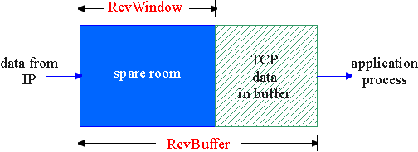
TCP Flow Control
flow control
Receive side of TCP connection has a receive buffer:
sender won’t overflow
receiver’s buffer by
transmitting too much,
too fast
Speed-matching service: matching the send rate to the receiving app’s drain rate
App process may be slow at reading from buffer

Slide 40
TCP Flow Control: How it Works
Rcvr advertises spare room by including value of RcvWindow in segments
Sender limits unACKed data to RcvWindow
Guarantees receive buffer doesn’t overflow
(Suppose TCP receiver discards out-of-order segments)
Spare room in buffer
= RcvWindow
= RcvBuffer-[LastByteRcvd - LastByteRead]

Slide 41
Technical Issue
Suppose RcvWindow=0 and that receiver has already ACK’d ALL packets in buffer
Sender does not transmit new packets until it hears RcvWindow>0
Receiver never sends RcvWindow>0 since it has no new ACKS to send to Sender
DEADLOCK!
Solution:
TCP specs require sender to continue sending packets with one data byte while RcvWindow=0, just to keep receiving ACKS from receiver
At some point the receiver’s buffer will empty and RcvWindow>0 will be transmitted back to sender

Slide 42
Exercises-2
1. A TCP connection is established between host A and host B, and the MSS length of TCP is 1000 bytes. If the current congestion window of host A is 4000 bytes, after host A sends two MSS segments to host B continuously, host A successfully receives the confirmation segment of the first segment sent by host B, and the size of the receiving window in the confirmation segment is 2000 bytes, then the maximum number of bytes that host A can also send to host B is ( )
1000
2000
3000
4000
Notes:
1000

Slide 43
Chapter 6 Outline
6.1 Transport-layer services
6.2 Multiplexing and demultiplexing
6.3 Connectionless transport: UDP
6.4 Connection-oriented transport: TCP
Segment structure
Connection management
Flow control
Reliable data transfer
6.5 TCP congestion control

Slide 44
Reliable Data Transfer: Getting Started
We’ll:
Incrementally develop sender, receiver sides of reliable data transfer protocol (rdt)
Consider only unidirectional data transfer
But control info will flow on both directions!
Use finite state machines (FSM) to specify sender, receiver
event causing state transition
actions taken on state transition
state: when in this “state” next state uniquely determined by next event
state
1
state
2
event
actions

Slide 45
Summary of the Protocols
Rdt1.0: all packets arrive correctly
Rdt2.0: all packets arrive, with possible errors only in data packets, and introducing ACK and NAK (no error)
Rdt2.1: corrupted ACKs/NAKs
Rdt2.2: similar to rdt2.1 remove NAKs
Rdt3.0: Allows packets to be lost and errors

Slide 46
Rdt1.0: Reliable Transfer over a Reliable Channel
Underlying channel perfectly reliable
No bit errors
No loss of packets
Separate FSMs for sender, receiver:
Sender sends data into underlying channel
Receiver read data from underlying channel
Wait for call from above
rdt_send(data)
Wait for call from below
rdt_rcv(packet)
packet = make_pkt(data)
udt_send(packet)
extract (packet,data)
deliver_data(data)
sender
receiver

Slide 47
Rdt2.0: Channel with Bit Errors
Underlying channel may flip bits in packet
FCS/Checksum to detect bit errors
The question: how to recover from errors:
Acknowledgements (ACKs): receiver explicitly tells sender that pkt received OK
Negative acknowledgements (NAKs): receiver explicitly tells sender that pkt had errors
Sender retransmits pkt on receipt of NAK
New mechanisms in rdt2.0 (beyond rdt1.0):
Error detection
Receiver feedback: control msgs (ACK,NAK) rcvr->sender
Notes:
Flip 快速翻转，flip bits比特受损

Slide 48
Rdt2.0: FSM specification
rdt_send(data)
receiver
snkpkt = make_pkt(data, FCS/checksum)
udt_send(sndpkt)
rdt_rcv(rcvpkt) &&
isNAK(rcvpkt)
rdt_rcv(rcvpkt) &&
corrupt(rcvpkt)
Wait for call from above
Wait for ACK or NAK
udt_send(NAK)
udt_send(sndpkt)
Wait for call from below
rdt_rcv(rcvpkt) && isACK(rcvpkt)
Λ
sender
rdt_rcv(rcvpkt) &&
notcorrupt(rcvpkt)
extract(rcvpkt,data)
deliver_data(data)
udt_send(ACK)

Slide 49
Rdt2.0: Operation with No Errors
rdt_send(data)
snkpkt = make_pkt(data, FCS/checksum)
udt_send(sndpkt)
receiver
rdt_rcv(rcvpkt) &&
isNAK(rcvpkt)
Wait for call from above
Wait for ACK or NAK
rdt_rcv(rcvpkt) &&
corrupt(rcvpkt)
udt_send(sndpkt)
udt_send(NAK)
rdt_rcv(rcvpkt) && isACK(rcvpkt)
Wait for call from below
Λ
sender
rdt_rcv(rcvpkt) &&
notcorrupt(rcvpkt)
extract(rcvpkt,data)
deliver_data(data)
udt_send(ACK)

Slide 50
Rdt2.0: Error Scenario
rdt_send(data)
snkpkt = make_pkt(data, FCS/checksum)
udt_send(sndpkt)
rdt_rcv(rcvpkt) &&
isNAK(rcvpkt)
Wait for call from above
Wait for ACK or NAK
rdt_rcv(rcvpkt) &&
corrupt(rcvpkt)
udt_send(sndpkt)
udt_send(NAK)
rdt_rcv(rcvpkt) && isACK(rcvpkt)
Wait for call from below
Λ
rdt_rcv(rcvpkt) &&
notcorrupt(rcvpkt)
extract(rcvpkt,data)
deliver_data(data)
udt_send(ACK)

Slide 51
Rdt2.0 Has a Fatal Flaw!
What happens if ACK/NAK corrupted?
Sender doesn’t know what happened at receiver!
Can’t just retransmit: possible duplicate
Handling duplicates:
Sender retransmits current pkt if ACK/NAK garbled
Sender adds sequence number to each pkt
Receiver discards (doesn’t deliver up) duplicate pkt
stop and wait
Sender sends one packet,
then waits for receiver
response
Notes:
Garbled:混乱的，引起误解的

Slide 52
Sender: whenever sender receives control message it sends a packet to receiver
A valid ACK: Sends next packet (if exists) with new sequence #
A NAK or corrupt response: resends old packet
Receiver: sends ACK/NAK to sender
If received packet is corrupt: send NAK
If received packet is valid and has different sequence # as prev packet: send ACK and deliver new data up
If received packet is valid and has same sequence # as prev packet, i.e., is a retransmission of duplicate: send ACK
Note: ACK/NAK do not contain sequence #

Slide 53
Rdt2.1: Sender, Handles Garbled ACK/NAKs
rdt_send(data)
sndpkt = make_pkt(0, data, FCS/checksum)
udt_send(sndpkt)
rdt_rcv(rcvpkt) &&
( corrupt(rcvpkt) ||
isNAK(rcvpkt) )
Wait for call 0 from above
Wait for ACK or NAK 0
udt_send(sndpkt)
rdt_rcv(rcvpkt)
&& notcorrupt(rcvpkt)
&& isACK(rcvpkt)
rdt_rcv(rcvpkt)
&& notcorrupt(rcvpkt)
&& isACK(rcvpkt)
Λ
Λ
Wait for ACK or NAK 1
Wait for
call 1 from above
rdt_rcv(rcvpkt) &&
( corrupt(rcvpkt) ||
isNAK(rcvpkt) )
rdt_send(data)
udt_send(sndpkt)
sndpkt = make_pkt(1, data, FCS/ checksum)
udt_send(sndpkt)

Slide 54
Rdt2.1: Receiver, Handles Garbled ACK/NAKs
rdt_rcv(rcvpkt) && notcorrupt(rcvpkt)
&& has_seq0(rcvpkt)
extract(rcvpkt,data)
deliver_data(data)
sndpkt = make_pkt(ACK, chksum)
udt_send(sndpkt)
rdt_rcv(rcvpkt) && (corrupt(rcvpkt)
rdt_rcv(rcvpkt) && (corrupt(rcvpkt)
sndpkt = make_pkt(NAK, chksum)
udt_send(sndpkt)
sndpkt = make_pkt(NAK, chksum)
udt_send(sndpkt)
Wait for
0 from below
Wait for
1 from below
rdt_rcv(rcvpkt) &&
not corrupt(rcvpkt) &&
has_seq1(rcvpkt)
rdt_rcv(rcvpkt) &&
not corrupt(rcvpkt) &&
has_seq0(rcvpkt)
sndpkt = make_pkt(ACK, chksum)
udt_send(sndpkt)
sndpkt = make_pkt(ACK, chksum)
udt_send(sndpkt)
rdt_rcv(rcvpkt) && notcorrupt(rcvpkt)
&& has_seq1(rcvpkt)
extract(rcvpkt,data)
deliver_data(data)
sndpkt = make_pkt(ACK, chksum)
udt_send(sndpkt)

Slide 55
Rdt2.1: Discussion
Sender:
Seq # added to pkt
Two seq. #’s (0,1) will suffice. Why?
Must check if received ACK/NAK corrupted
Twice as many states
State must “remember” whether “current” pkt has 0 or 1 seq. #
Receiver:
Must check if received packet is duplicate
State indicates whether 0 or 1 is expected pkt seq #
Note: receiver can not know if its last ACK/NAK received OK at sender

Slide 56
Rdt2.2: a NAK-free Protocol
Same functionality as rdt2.1, using ACKs only
Instead of NAK, receiver sends ACK for last pkt received OK
Receiver must explicitly include seq # of pkt being ACKed
Duplicate ACK at sender results in same action as NAK: retransmit current pkt

Slide 57
Rdt2.2: Sender, Receiver Fragments
rdt_send(data)
sndpkt = make_pkt(0, data, FCS/checksum)
udt_send(sndpkt)
rdt_rcv(rcvpkt) &&
( corrupt(rcvpkt) ||
isACK(rcvpkt,1) )
Wait for call 0 from above
Wait for ACK
0
udt_send(sndpkt)
sender FSM
fragment
rdt_rcv(rcvpkt)
&& notcorrupt(rcvpkt)
&& isACK(rcvpkt,0)
rdt_rcv(rcvpkt) &&
(corrupt(rcvpkt) ||
has_seq1(rcvpkt))
Λ
Wait for
0 from below
receiver FSM
fragment
udt_send(sndpkt)
rdt_rcv(rcvpkt) && notcorrupt(rcvpkt)
&& has_seq1(rcvpkt)
extract(rcvpkt,data)
deliver_data(data)
sndpkt = make_pkt(ACK1, chksum)
udt_send(sndpkt)

Slide 58
Rdt3.0: Channels with Errors and Loss
New assumption: Underlying channel can also lose packets (data or ACKs)
Checksum, seq. #, ACKs, retransmissions will be of help, but not enough
Q: how to deal with loss?
Sender waits until certain data or ACK lost, then retransmits
Any drawbacks?
Approach: sender waits “reasonable” amount of time for ACK
Retransmits if no ACK received in this time
If pkt (or ACK) just delayed (not lost):
Retransmission will be duplicate, but use of seq. #’s already handles this
Receiver must specify seq # of pkt being ACKed
Requires countdown timer

Slide 59
Rdt3.0 Sender
rdt_send(data)
rdt_rcv(rcvpkt) &&
( corrupt(rcvpkt) ||
isACK(rcvpkt,1) )
sndpkt = make_pkt(0, data, FCS/checksum)
udt_send(sndpkt)
start_timer
rdt_rcv(rcvpkt)
Λ
Λ
Wait for
call 0 from above
Wait for ACK0
timeout
udt_send(sndpkt)
start_timer
rdt_rcv(rcvpkt)
&& notcorrupt(rcvpkt)
&& isACK(rcvpkt,1)
rdt_rcv(rcvpkt)
&& notcorrupt(rcvpkt)
&& isACK(rcvpkt,0)
stop_timer
stop_timer
Wait for ACK1
Wait for
call 1 from above
timeout
udt_send(sndpkt)
start_timer
rdt_rcv(rcvpkt)
rdt_send(data)
Λ
rdt_rcv(rcvpkt) &&
( corrupt(rcvpkt) ||
isACK(rcvpkt,0) )
sndpkt = make_pkt(1, data, checksum)
udt_send(sndpkt)
start_timer
Λ

Slide 60
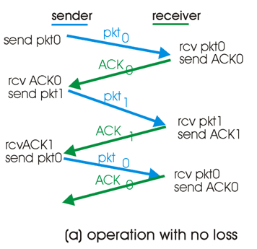
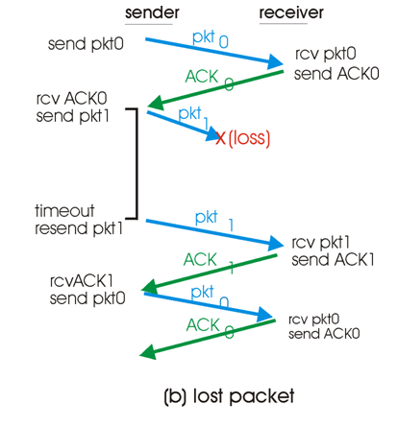
Rdt3.0 In Action

Slide 61
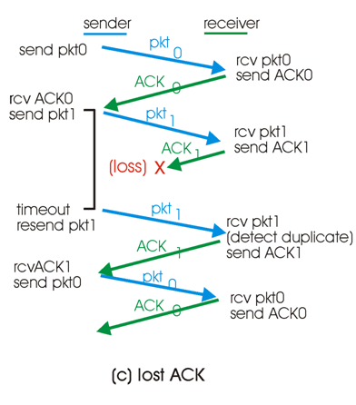
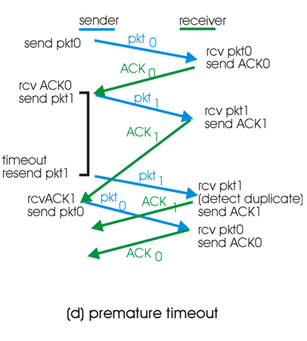
Rdt3.0 In Action

Slide 62
Performance of rdt3.0
Rdt3.0 works, but performance stinks
Example: 1 Gbps link, 15 ms e-e prop. delay, 1KB packet:
T
=
L (packet length in bits)
8kb/pkt
transmit
=
= 8 microsec
R (transmission rate, bps)
10**9 b/sec
U _{sender}: utilization – fraction of time sender busy sending
1KB pkt every 30 msec -> 33kB/sec thruput over 1 Gbps link
Network protocol limits use of physical resources!
Notes:
Stink:让人觉得很糟糕

Slide 63
Rdt3.0: Stop-and-Wait Operation
sender
receiver
first packet bit transmitted, t = 0
last packet bit transmitted, t = L / R
first packet bit arrives
RTT
last packet bit arrives, send ACK
ACK arrives, send next
packet, t = RTT + L / R

Slide 64
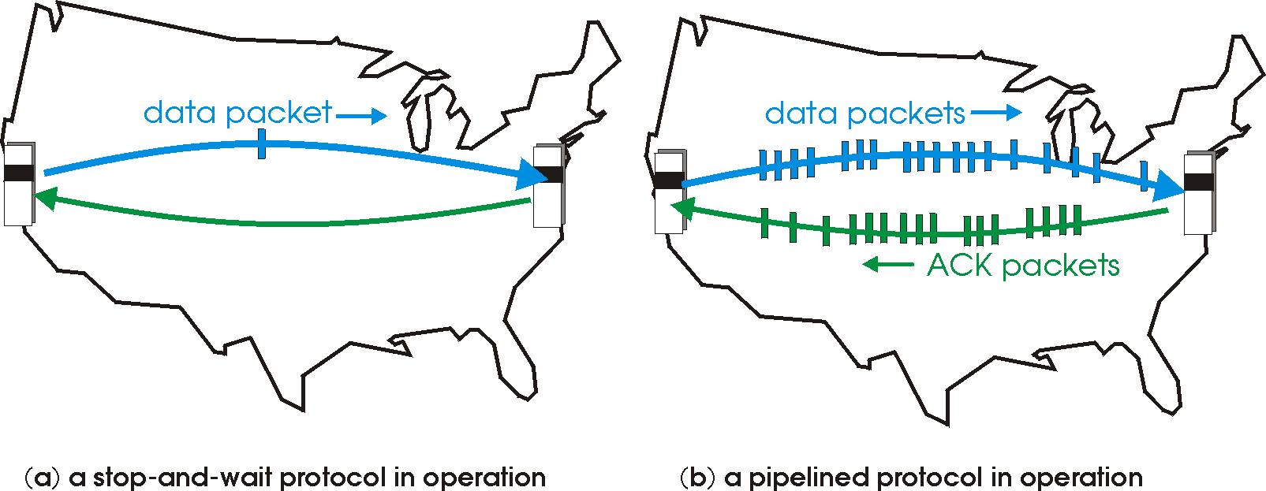
Pipelined Protocols
Pipelining: sender allows multiple, “in-flight”, yet-to-be-acknowledged pkts
Range of sequence numbers must be increased
Buffering at sender and/or receiver

Slide 65
Pipelining: Increased Utilization
sender
receiver
first packet bit transmitted, t = 0
last bit transmitted, t = L / R
first packet bit arrives
RTT
last packet bit arrives, send ACK
last bit of 2nd packet arrives, send ACK
last bit of 3rd packet arrives, send ACK
ACK arrives, send next
packet, t = RTT + L / R
Increase utilization
by a factor of 3!

Slide 66
Pipelined Protocols
Advantage: much better bandwidth utilization than stop-and-wait
Disadvantage: More complicated to deal with reliability issues, e.g., corrupted, lost, out of order data.
Two generic approaches to solving this
Go-Back-N protocols
Selective repeat protocols

Slide 67
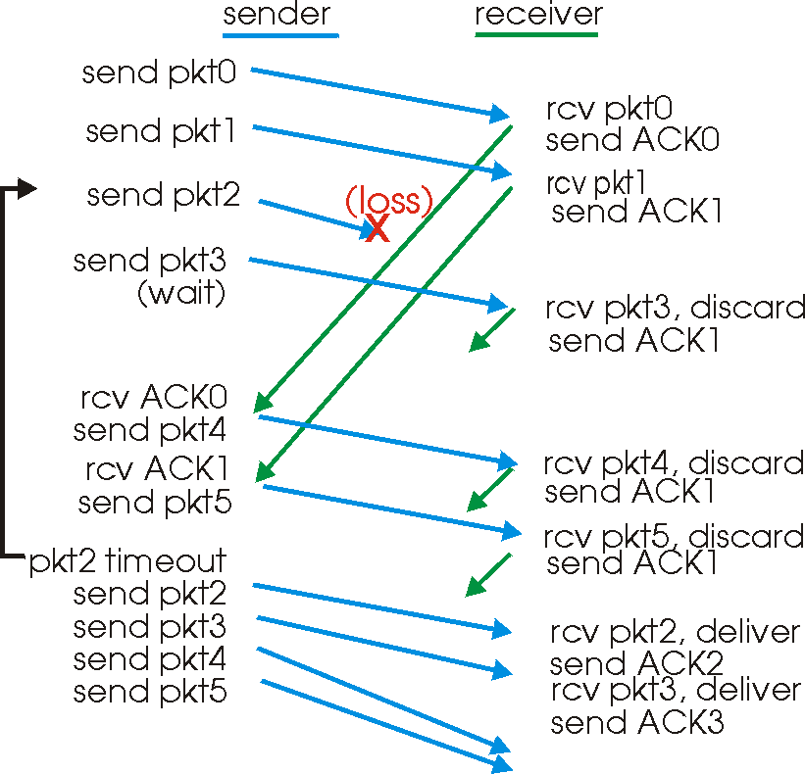
GBN In Action

Slide 68
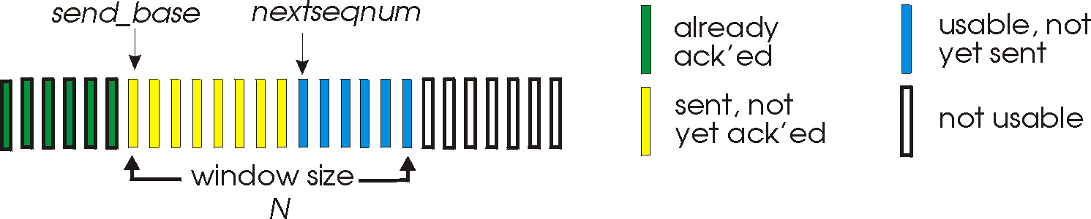
Go-Back-N
Sender:
K-bit seq # in pkt header
“Window” of up to N, consecutive unack’ed pkts allowed
ACK(n): ACKs all pkts up to, including seq # n - “cumulative ACK”
May receive duplicate ACKs (see receiver)
Timer for each in-flight pkt
Timeout(n): retransmit pkt n and all higher seq # pkts in window
Called a sliding-window protocol

Slide 69
GBN: Sender
rdt_Send() called: checks to see if window is full
No: send out packet
Yes: return data to upper level
Receipt of ACK(n): cumulative acknowledgement that all packets up to and including n have been received. Updates window accordingly and restarts timer
Timeout: resends ALL packets that have been sent but not yet acknowledged.
This is only event that triggers resend

Slide 70
GBN: Sender Extended FSM
rdt_send(data)
if (nextseqnum < base+N) {
sndpkt[nextseqnum] = make_pkt(nextseqnum,data,chksum)
udt_send(sndpkt[nextseqnum])
if (base == nextseqnum)
start_timer
nextseqnum++
}
else
refuse_data(data)
Λ
base=1
nextseqnum=1
timeout
Wait
start_timer
udt_send(sndpkt[base])
udt_send(sndpkt[base+1])
…
udt_send(sndpkt[nextseqnum-1])
rdt_rcv(rcvpkt)
&& corrupt(rcvpkt)
rdt_rcv(rcvpkt) &&
notcorrupt(rcvpkt)
base = getacknum(rcvpkt)+1
If (base == nextseqnum)
stop_timer
else
start_timer

Slide 71
GBN: Receiver Extended FSM
default
udt_send(sndpkt)
rdt_rcv(rcvpkt)
&& notcurrupt(rcvpkt)
&& hasseqnum(rcvpkt,expectedseqnum)
Λ
Wait
extract(rcvpkt,data)
deliver_data(data)
sndpkt = make_pkt(expectedseqnum,ACK,chksum)
udt_send(sndpkt)
expectedseqnum++
expectedseqnum=1
sndpkt =
make_pkt(expectedseqnum,ACK,chksum)
If expected packet received:
Send ACK and deliver packet upstairs
If out-of-order packet received:
Discard (don’t buffer) -> no receiver buffering!
Re-ACK pkt with highest in-order seq #
May generate duplicate ACKs
Notes:
If expected packet received:
Send ACK and deliver packet upstairs
If out-of-order packet received:
discard (don’t buffer) -> no receiver buffering!
Re-ACK pkt with highest in-order seq #
may generate duplicate ACKs

Slide 72
More on Receiver
ACK-only: the receiver always sends ACK for last correctly received packet with highest in-order seq #
Receiver only sends ACKS (no NAKs)
Need only remember expectedseqnum
Can generate duplicate ACKs

Slide 73
GBN is easy to code but might have performance problems
In particular, if many packets are in pipeline at one time (bandwidth-delay product large) then one error can force retransmission of huge amounts of data!
Selective Repeat protocol allows receiver to buffer data and only forces retransmission of required packets
Notes:
.

Slide 74
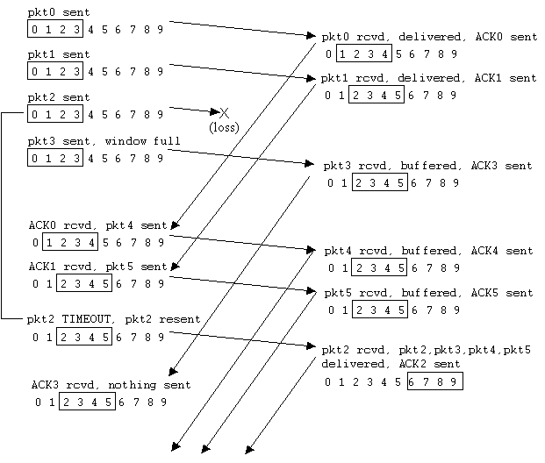
Selective Repeat In Action

Slide 75
Selective Repeat
Receiver individually acknowledges all correctly received pkts
Buffers pkts, as needed, for eventual in-order delivery to upper layer
Sender only resends pkts for which ACK not received
Sender timer for each unACKed pkt
Compare to GBN which only had timer for base packet
Sender window
N consecutive seq #’s
Again limits seq #s of sent, unACKed pkts
Important: Window size < seq # range

Slide 76
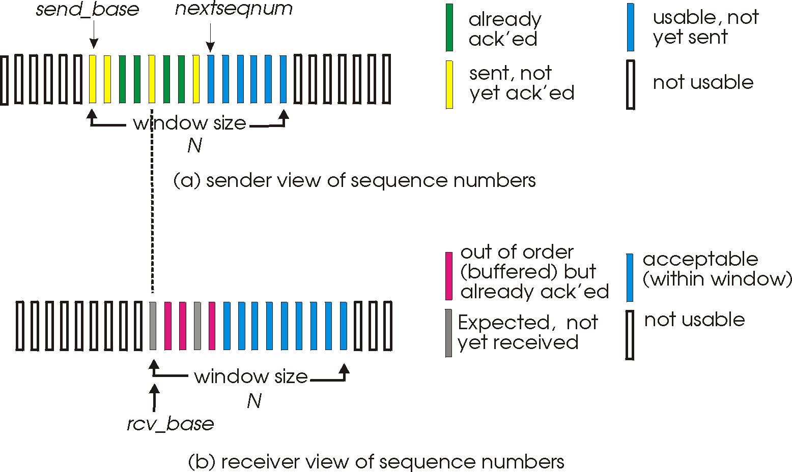
Selective Repeat: Sender, Receiver Windows

Slide 77
Selective Repeat
sender
receiver
Data from above :
If next available seq # in window, send pkt
Timeout(n):
Resend pkt n, restart timer
ACK(n) in [sendbase,sendbase+N]:
Mark pkt n as received
If n smallest unACKed pkt, advance window base to next unACKed seq #
pkt n in [rcvbase, rcvbase+N-1]
Send ACK(n)
Out-of-order: buffer
In-order: deliver (also deliver buffered, in-order pkts), advance window to next not-yet-received pkt
pkt n in [rcvbase-N,rcvbase-1]
ACK(n)
Otherwise:
Ignore

Slide 78
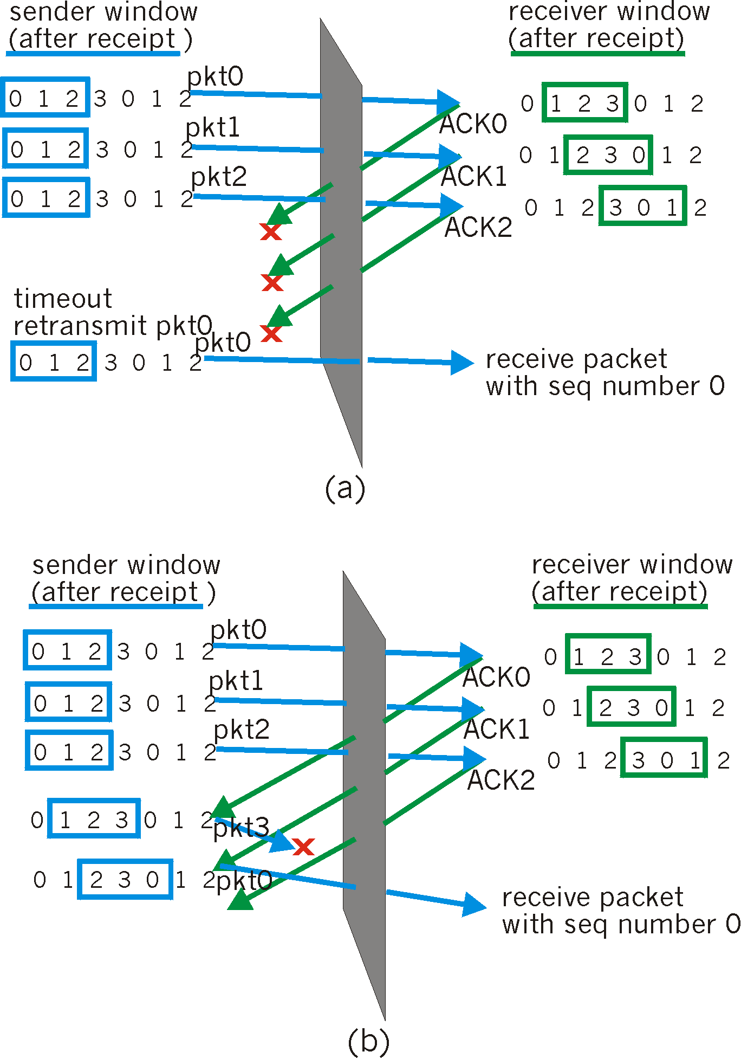
Selective Repeat: Dilemma
Example:
seq #’s: 0, 1, 2, 3
window size=3
Receiver sees no difference in two scenarios!
Incorrectly passes duplicate data as new in (a)
Q: what relationship between seq # size and window size?

Slide 79
GBN vs. Selective Repeat
Selective repeat is more complicated as it needs buffering at the receiver, but only retransmit packets required for retransmission
GBN is simpler, but can lead to large number of unnecessary retransmission

Slide 80
TCP Reliable Data Transfer
TCP creates rdt service on top of IP’s unreliable service
Pipelined segments
Cumulative acks
TCP uses single retransmission timer
Retransmissions are triggered by:
Timeout events
Duplicate acks
Initially consider simplified TCP sender:
Ignore duplicate acks
Ignore flow control, congestion control

Slide 81
TCP sender (simplified)
data received from application above
create segment, seq. #: NextSeqNum
pass segment to IP (i.e., “send”)
NextSeqNum = NextSeqNum + length(data)
if (timer currently not running)
start timer
Λ
NextSeqNum = InitialSeqNum
SendBase = InitialSeqNum
wait
for
event
timeout
retransmit not-yet-acked segment with smallest seq. #
start timer
ACK received, with ACK field value y
if (y > SendBase) {
SendBase = y %cumulative acks
/* SendBase–1: last cumulatively ACKed byte */
if (there are currently not-yet-acked segments)
start timer
else stop timer
}

Slide 82
TCP Seq. #’s and ACKs
Seq. #’s:
Byte stream “number” of first byte in segment’s data
ACKs:
Seq # of next byte expected from other side
Cumulative ACK: TCP only acknowledge bytes up to the first missing byte in the stream
Host A
Host B
Bytes [0~535]
Seq=XX1, ACK=536, data = ‘YYYY’
… …
Bytes [0~535], [900,1000]
Seq=XXN, ACK=536, data = ‘ZZZZ’
Q: how receiver handles out-of-order segments?
A: TCP spec doesn’t say, - up to implementer

Slide 83
TCP: Retransmission Scenarios
Host A
Host B
Host A
Host B
Seq=92, 8 bytes data
Seq=92, 8 bytes data
Seq=100, 20 bytes data
timeout
ACK=100
Seq=92 timeout
X
ACK=100
loss
ACK=120
Seq=92, 8 bytes data
Sendbase
= 100
Seq=92, 8 bytes data
SendBase
= 120
Seq=92 timeout
ACK=120
ACK=100
SendBase
= 100
SendBase
= 120
time
premature timeout
time
lost ACK scenario

Slide 84
TCP Retransmission Scenarios (more)
Host A
Host B
Seq=92, 8 bytes data
ACK=100
timeout
Seq=100, 20 bytes data
X
loss
SendBase
= 120
ACK=120
time
Cumulative ACK scenario

Slide 85
TCP Round Trip Time and Timeout
Q: how to set TCP timeout value?
Longer than RTT
But RTT varies
Too short: premature timeout
Unnecessary retransmissions
Too long: slow reaction to segment loss
Q: how to estimate RTT?
SampleRTT: measured time from segment transmission until ACK receipt
Ignore retransmissions
SampleRTT will vary, want estimated RTT “smoother”
Average several recent measurements, not just current SampleRTT

Slide 86
TCP round trip time, timeout
EstimatedRTT = (1- α)*EstimatedRTT + α*SampleRTT
Exponential Weighted Moving Average
influence of past sample decreases exponentially fast
typical value: α = 0.125
RTT: gaia.cs.umass.edu to fantasia.eurecom.fr
RTT (milliseconds)
sampleRTT
EstimatedRTT
time (seconds)
Notes:
exponential weighted moving average：EWMA,指数加权移动平均法，统计学观点，是指各数值的加权系数随时间呈指数式递减，越靠近当前时刻的数值加权系数越大。基本思想是加权平均对最近的样本赋予的权值要大于老样本的权重.采用该方法的理由：观察期的近期观察值对预测值有较大影响，它更能反映近期变化的趋势。相对于传统平均法的优势：一是不需要保存过去所有的数值，二是计算量显著减少。
EWMA 的表达式如下：
vt=βvt−1+(1−β)θtvt=βvt−1+(1−β)θt
上式中 θtθt 为时刻 tt 的实际温度；系数 ββ 表示加权下降的速率，其值越小下降的越快；vt 为 tt 时刻 EWMA 的值。
在 t=0时刻，一般初始化 v0=0 ，对 EWMA 的表达式进行归纳可以将 t 时刻的表达式写成：
vt=(1−β)(θt+βθt−1+...+^{βt−1}θ1)vt=(1−β)(θt+βθ_{t−1}+...+β^{t−1}θ₁)
influence of past sample decreases exponentially fast：过去样本的影响以指数级的速度衰减
图中可见，sampleRTT在计算EstimatedRTT过程中趋于平缓

Slide 87

TCP round trip time, timeout
timeout interval: EstimatedRTT plus “safety margin”
large variation in EstimatedRTT -> larger safety margin
estimate SampleRTT deviation from EstimatedRTT:
DevRTT = (1-β)*DevRTT +
β*|SampleRTT-EstimatedRTT|
(typically, β = 0.25)
TimeoutInterval = EstimatedRTT + 4*DevRTT
estimated RTT
“safety margin”
Notes:
除了估算RTT外，测量RTT的变化也是有价值的。考虑RTT的波动，估计EstimatedRTT与SampleRTT的偏差

Slide 88
More on Sender Policies
Doubling the Timeout Interval
Used by most TCP implementations
If timeout occurs then, after retransmisison, Timeout Interval is doubled
Intervals grow exponentially with each consecutive timeout
When Timer restarted because of (i) new data from above or (ii) ACK received, then Timeout Interval is reset as described previously using Estimated RTT and DevRTT.
Limited form of Congestion Control
Notes:
每一次TCP重传均将下一次超时间隔设为先前值的两倍
思考：这种思路和什么很相似？CSMA/CD中的二进制
如果TCP是一种停止等待协议，那么将超时间隔加倍就足以作为一种拥塞控制机制。然而，TCP使用流水线（因此不是停止等待协议），这允许发送方拥有多个未确认的未确认段。超时时间间隔的加倍不会阻止TCP发送方向网络发送大量首次传输的数据包，即使在端到端路径高度拥挤的情况下也是如此。因此，当出现网络拥塞迹象时，需要一种拥塞控制机制来阻止“从上述应用程序接收的数据”的流动。

Slide 89
TCP fast retransmit
time-out period often relatively long:
long delay before resending lost packet
detect lost segments via duplicate ACKs.
sender often sends many segments back-to-back
if segment is lost, there will likely be many duplicate ACKs.
TCP fast retransmit
if sender receives “triple duplicate ACKs” for same data, resend unacked segment with smallest seq #
likely that unacked segment lost, so don’t wait for timeout
Notes:
RTT的这种机制可能会增加对丢包处理的时延，怎么办？

Slide 90
TCP fast retransmit
Host A
Host B
Seq=92, 8 bytes of data
Seq=100, 20 bytes of data
X
ACK=100
timeout
ACK=100
ACK=100
ACK=100
Seq=100, 20 bytes of data
fast retransmit after sender
receipt of triple duplicate ACK

Slide 91
TCP ACK Generation [RFC 1122, RFC 2581]
Event at Receiver
Arrival of in-order segment with
expected seq #. All data up to
expected seq # already ACKed
Arrival of in-order segment with
expected seq #. One other
segment has ACK pending
Arrival of out-of-order segment
higher-than-expect seq. # .
Gap detected
Arrival of segment that
partially or completely fills gap
TCP Receiver action
Delayed ACK. Wait up to 500ms
for next segment. If no next segment,
send ACK
Immediately send single cumulative
ACK, ACKing both in-order segments
Immediately send duplicate ACK,
indicating seq. # of next expected byte
Immediate send ACK, provided that
segment starts at lower end of gap
Notes:
事件1：到达一个按序段，且前面的段都按需到达且确认，此时可以等一等，等是否可以背回或等下一个段到达然后一起确认，但最长等待时间不超过500ms
事件2：到达一个按序段，但前面一个还没确认，此时马上发单个累积确认，TCP协议要求每隔一个段就要发ACK
事件3：失序段到达，马上发累积确认，指示发送方重发
事件4：能填充间隔段到达，若该段起始于间隔的低端，立即发ACK

Slide 92
TCP: GBN or Selective Repeat?
Basic TCP looks a lot like GBN
Many TCP implementations will buffer received out-of-order segments and then ACK them all after filling in the range
This looks a lot like Selective Repeat
TCP is a hybrid

Slide 93
Exercises-3
1. A TCP connection has been established between host A and host B. host A sends three consecutive TCP segments to host B, including 300 bytes, 400 bytes and 500 bytes payload respectively. The sequence number of the third segment is 900. If host B receives only the first and third segments correctly, the confirmation sequence number sent by host B to host A is( )
300
500
1200
1400
Notes:
500

Slide 94
Chapter 6 Outline
6.1 Transport-layer services
6.2 Multiplexing and demultiplexing
6.3 Connectionless transport: UDP
6.4 Connection-oriented transport: TCP
Segment structure
Connection management
Reliable data transfer
6.5 TCP congestion control

Slide 95
Principles of Congestion Control
Congestion:
Informally: “too many sources sending too much data too fast for network to handle”
Different from flow control!
Manifestations:
Lost packets (buffer overflow at routers)
Long delays (queueing in router buffers)
A top-10 problem!
congested network
high capacity receiver
congestion control problem

Slide 96
Approaches towards Congestion Control
Two broad approaches towards congestion control:
End-end congestion control:
No explicit feedback from network
Congestion inferred from end-system observed loss, delay
Approach taken by TCP
Network-assisted congestion control:
Routers provide feedback to end systems
Single bit indicating congestion (SNA, DECbit, TCP/IP ECN, ATM)
Explicit rate sender should send at
Notes:
IBM的SNA、DEC的DECnet、TCP/IP、ATM等体系结构中采用让路由器用一个比特来指示网络中的拥塞情况，即显式地反馈网络拥塞状态

Slide 97
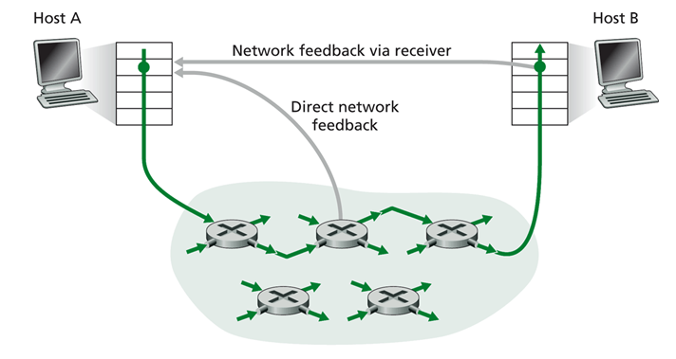
Two Ways for Providing Feedback

Slide 98
TCP Congestion Control
End-to-end control (no network assistance)
Transmission rate limited by congestion window size, Congwin, over segments
Congwin dynamically modified to reflect perceived congestion
Tools are “similar” to flow control
sender limits transmission using:
LastByteSent-LastByteAcked ≤ CongWin
How does sender perceive congestion?
loss event = timeout or 3 duplicate ACKs
TCP sender reduces rate (CongWin) after loss event
Notes:
perceived congestion：所感知到的拥塞
TCP拥塞控制思路：让发送方根据所感知的网络拥塞程度，来限制其能向连接发送流量的速率
如何限制发送速率：设置拥塞窗口
如何感知网络拥塞：出现丢包事件
速率算法的改变：TCP拥塞算法

Slide 99
TCP Congestion Control Algorithms
Three mechanisms:
AIMD = Additive Increase Multiplicative Decrease
Slow start = CongWin set to 1 and then grows exponentially
Conservative after timeout events
Notes:
Conservative 保守的

Slide 100
TCP AIMD
Multiplicative decrease: cut CongWin in half after loss event
Additive increase: increase CongWin by 1 MSS every RTT in the absence of loss events: probing also known as congestion avoidance
Long-lived TCP connection

Slide 101
TCP Slow Start
When connection begins, CongWin = 1 MSS
Example: MSS = 500 bytes & RTT = 200 msec
Initial rate = 20 kbps
Available bandwidth may be >> MSS/RTT
Desirable to quickly ramp up to respectable rate
When connection begins, increase rate exponentially fast until first loss event
Slow Start is NOT really Slow!

Slide 102
TCP Slow Start (more)
When connection begins, increase rate exponentially until first loss event:
Double CongWin every RTT
Done by incrementing CongWin for every ACK received
Summary: initial rate is slow but ramps up exponentially fast
Host A
Host B
one segment
RTT
two segments
four segments
time

Slide 103
So Far
Slow-Start: ramps up exponentially
Followed by AIMD: sawtooth pattern
Q: When should the exponential increase switch to linear?
Reality (TCP Reno)
Introduce new variable threshold: initially very large
Slow-Start exponential growth stops when reaches threshold and then switches to AIMD
Two different types of loss events
3 dup ACKS: cut CongWin in half and set threshold=CongWin (now in standard AIMD)
Timeout: set threshold=CongWin/2, CongWin=1 and switch to Slow-Start

Slide 104
Reason for treating 3 dup ACKS differently than timeout is that:
3 dup ACKs indicates network capable of delivering some segments while
Timeout before 3 dup ACKs is “more alarming”
Note that older protocol, TCP Tahoe, treated both types of loss events the same and always goes to slow-start with Congwin=1 after a loss event
TCP Reno’s skipping of the slow start for a 3-DUP-ACK loss event is known as fast-recovery

Slide 105
Summary: TCP Congestion Control
When CongWin is below Threshold, sender in slow-start phase, window grows exponentially
When CongWin is above Threshold, sender is in congestion-avoidance phase, window grows linearly
When a triple duplicate ACK occurs, Threshold set to CongWin/2 and CongWin set to Threshold (only in TCP Reno)
When timeout occurs, Threshold set to CongWin/2 and CongWin is set to 1 MSS (TCP Tahoe does this for 3 Dup Acks as well)

Slide 106
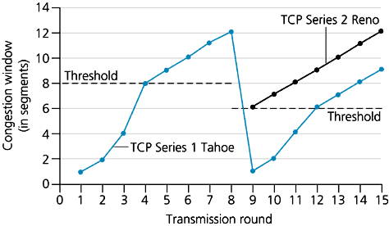
The Big Picture

Slide 107
TCP Sender Congestion Control
Event | State | TCP Sender Action | Commentary
ACK receipt for previously unacked data | Slow Start (SS) | CongWin = CongWin + MSS, If (CongWin > Threshold) set state to “Congestion Avoidance” | Resulting in a doubling of CongWin every RTT
ACK receipt for previously unacked data | Congestion Avoidance (CA) | CongWin = CongWin+MSS * (MSS/CongWin) | Additive increase, resulting in increase of CongWin by 1 MSS every RTT
Loss event detected by triple duplicate ACK | SS or CA | Threshold = CongWin/2, CongWin = Threshold, Set state to “Congestion Avoidance” | Fast recovery, implementing multiplicative decrease. CongWin will not drop below 1 MSS
Timeout | SS or CA | Threshold = CongWin/2, CongWin = 1 MSS, Set state to “Slow Start” | Enter slow start
Duplicate ACK | SS or CA | Increment duplicate ACK count for segment being acked | CongWin and Threshold not changed

Slide 108
Exercises-4
1. A TCP connection always sends TCP segments with 1KB MSS. The sender has enough data to send. A timeout event occurs when the congestion window is 16KB. If the transmission of TCP segments in the next four RTTS is successful, when all TCP segments sent in the fourth RTT receive positive responses, the size of the congestion window is( )
7KB
8KB
9KB
16KB
Notes:
9KB

Slide 109
Chapter 6: Summary
Principles behind transport layer services:
Multiplexing, demultiplexing
Reliable data transfer
Congestion control
Instantiation and implementation in the Internet
UDP
TCP

Slide 110
Homework
P538:14,15
P322:27
P323:28
P326:42,43

